Slide 1
Subqueries

Slide 2
SQL Subqueries:
Queries within Queries
When data to be filtered is known, we put the filter condition with Where clause.
What to do when we don’t know what the filter value is OR we don’t want to hardcode a value into the query ?
If the filter can be found elsewhere in the database then we can put a subquery in the Where clause.

Slide 3
Example(s):
Enlist the names of students who have secured marks more than the average of all students in maths.
Q:
select names from student where maths> (select avg(maths) from student);
Find the employees who have the same position as ‘Ritesh’
Q:select * from emp where position = ( select position from emp where ename = ‘Ritesh’);

Slide 4
Types of subqueries:
Single Row:
- Sub query which returns single row output to the outer SQL statement.
- A single row subquery returns zero or one row to the outer SQL statement.
- Single row comparison operators i.e. >,= are used with WHERE conditions.
Multiple Row:
- The subquery returns more than one row.
- Multiple row subquery returns one or more rows to the outer SQL statement.
- Multiple row comparison operators like IN, ANY, ALL are used in the comparisons.

Slide 5
Single row subquery examples:
Display the details of employees to whom the company is paying minimum salary.
SELECT first_name, salary, department_id FROM employees WHERE salary = (SELECT MIN (salary) FROM employees);
Enlist the names of students who are older than the average student Age.
SELECT stuname FROM student WHERE age > (SELECT AVG(age) FROM student);

Slide 6
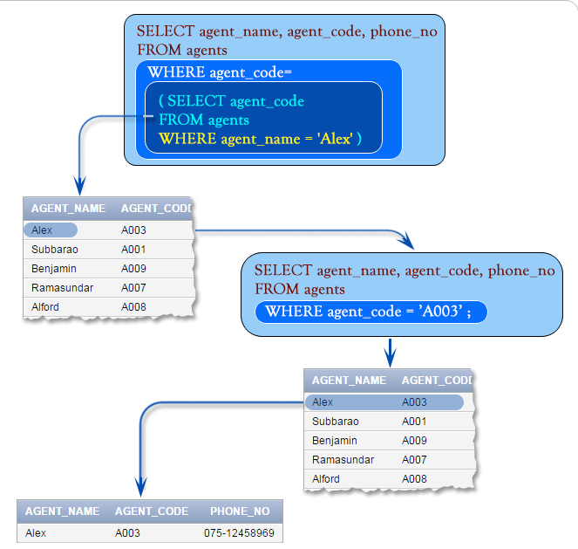

Slide 7
Ex1:
Condition in outer query : the 'ord_amount' of 'orders' table must be greater than the average 'ord_amount' of 'orders' table with following condition an inner join.
Condition in inner query : 'ord_date' of 'orders' table must be '20-APR-08' for calculating the average 'ord_amount'.

Slide 8
SELECT ord_num,ord_amount,ord_date,cust_code, agent_code FROM orders WHERE ord_amount>
(SELECT AVG(ord_amount) FROM orders WHERE ord_date='20-APR-08');
Pictorial view:

Slide 9
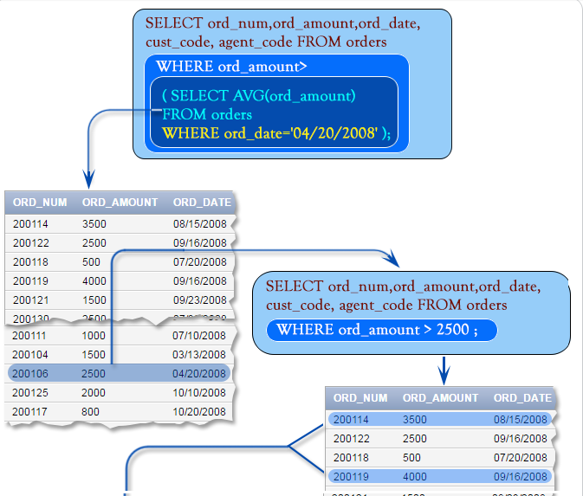
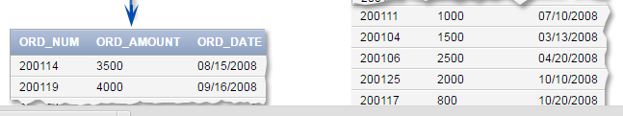

Slide 10
multiple rows subquery examples:
Find the employees whose salary is equal to the salary of at least one employee in department of id 5?
SELECT employee_id, salary FROM employees WHERE salary IN ( SELECT salary FROM employees WHERE department_id = 5 )
Enlist the any employee who belongs to the department located at ‘Mumbai’.
SELECT employee_id, emp_name FROM employees WHERE dept_no =ANY ( SELECT dept_no FROM department WHERE dept_location = ‘Mumbai’ )

Slide 11
in outer query : 'agent_code' should be any 'agent_code' from 'customer' table
in inner query : 'cust_country' in the 'customer' table must be 'UK',
Queries:
SELECT agent_code,agent_name,working_area,commission FROM agents WHERE agent_code=ANY( SELECT agent_code FROM customer WHERE cust_country='UK');

Slide 12
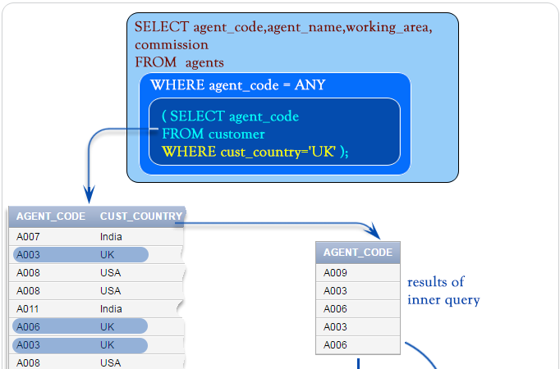

Slide 13
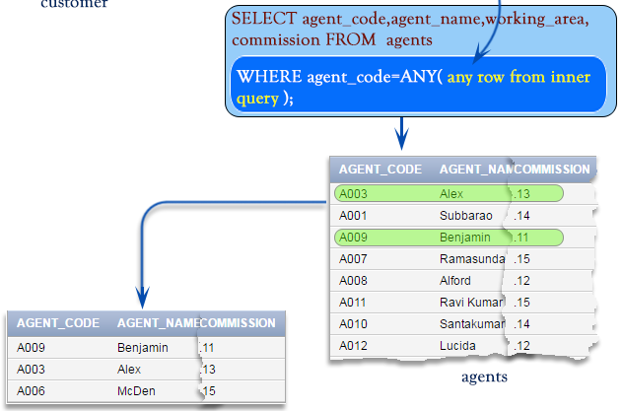

Slide 14
Execution order of Subqueries:
The basic concept is to pass a single value or many
values from the innermost subquery to the next (one level up) query and so on.
4
3
2
1
When reading or writing SQL subqueries, you should start from the bottom upwards, working out which data is to be passed to the next query up.

Slide 15
University Database:
Student names are held in the STUDENT table
Student marks are recorded in the MARKS table but marks are allocated against the STUDENTID
Question:
List the names of the students who have failed in the subject ‘COMP1011’.

Slide 16
single queries:
To identify the students who have failed in subject COMP1011
Select stu_id
From marks
Where sub_id = ‘COMP1011’
And grade < 40;
To retrieve a name based on a student id
Select stu_name
From student
Where stu_id = 9292145;

Slide 17
nested query (subquery):
Select stu_name
From Student
Where stu_id in ( select stu_id
From marks
Where sub_id = ‘COMP1011’
And grade < 40);
Retrieve a list of student id’s who have mark < 40 for COMP1011
Retrieve the name of the studentid’s in this list.

Slide 18
Rules for Subqueries:
The data types must match. i.e.if the stu_id expects a number then the subquery must return a number.
Remember = means that it is expecting a single value, you must therefore be sure that the subquery returns only 1 result, if there is any doubt you should use the IN keyword.
You can nest / use as many subqueries as you like.
This is not a very efficient way of coding or pulling data from multiple tables, and you may be able to generate the required result using joins (covered later in the syllabus)

Slide 19
comparators:
= equal to
> greater than
>= greater than or equal to
< less than
<= less than or equal to
<> not equal to
and other keywords ……
IN
NOT IN
ANY
ALL

Slide 20
Multiple row subqueries:
Consider the following tables:
Agents( agent_code, agent_name,work_area,phone,commission,country)
Orders(ord_no,ord_amt,advance_amt,ord_date,cust_code,agent_code,ord_description)
IN: IN operator is used to check a value within a set of values. The list of values may come from the results returned by a subquery.
Example: SELECT ord_no,ord_amt,ord_date,
cust_code, agent_code FROM orders WHERE agent_code IN(SELECT agent_code FROM agents WHERE working_area='Bangalore');

Slide 21
Multiple row subqueries:
NOT IN: Opposite of IN operator
SELECT ord_num,ord_amount,ord_date, cust_code, agent_code
FROM orders WHERE agent_code NOT IN( SELECT agent_code FROM agents WHERE working_area='Bangalore');
ANY: You can use the ANY operator to compare a value with any value in a list. You must place an =, <>, >, <, <= or >= operator before ANY in your query.
Q: Enlist if any of the agent who belongs to the country 'UK'
SELECT agent_code,agent_name,working_area,commission
FROM agents WHERE agent_code = ANY( SELECT agent_code
FROM customer WHERE cust_country='UK');

Slide 22
Multiple row subqueries:
ALL:Compares a value to every value in a list or returned by a query. Must be preceded by =, !=, >, <, <=, >=. Evaluates to TRUE if the query returns no rows.
Q: Select employees whose salary is greater than every salesman’s salary:
select ename from emp where sal > all ( select sal
from emp where job = 'SALESMAN');

Slide 23
Group by and having clause:
GROUP BY:Groups rows based on distinct values which exists for specified column.
Q: Retrieve the product numbers and total quantity ordered for each product from the sales_order_details table.
Sales_order_details(p_no,qty,qty_dis,description)
A: select p_no,sum(qty) “Total Qty Ordered” from sales_order_details GROUP BY p_no;

Slide 24
Group by and having clause:
HAVING:Used in conjunction with GROUP BY clause. It imposes a condition on GROUP BY clause which further filters the groups created by the GROUP BY clause.
Q: Retrieve the product numbers and total quantity ordered for products ‘P001’, ‘P005’ from the sales_order_details. table.
A: select p_no,sum(qty) “Total Qty Ordered” from sales_order_details GROUP BY p_no
HAVING p_no=‘P001’ OR p_no=‘P005’;

Slide 25
Multiple column subqueries:
You can write subqueries that return multiple columns. The following example retrieves the order amount with lowest price, group by agent.
select ord_num, agent_code, ord_date, ord_amount
from orders where(agent_code, ord_amount) IN
(SELECT agent_code, MIN(ord_amount)
FROM orders GROUP BY agent_code);

Slide 26
SQL> select * from t2;
EID ENAME SAL JOB
---------- ---------- ---------- ----------
1 neha 2000 analyst
2 mita 3000 clerk
3 neha1 4000 clerk
4 yash 5000 manager
5 srushti 6000 manager
6 purva 7000 salesman
6 rows selected.

Slide 27
SQL> select sal from t2 where job='manager';
SAL
----------
5000
6000
SQL> select ename,sal from t2 where sal>any(select sal from t2 where job='manager');
ENAME SAL
---------- ----------
srushti 6000
purva 7000

Slide 28
SQL> select ename,sal from t2 where sal>all(select sal from t2 where job='manager');
ENAME SAL
---------- ----------
purva 7000

